Slide 1


Interpretation of Data Assignment II
Érin Kennedy
Interpretation of Data
Masters of Science in Data Analytics
Notes:
Hi my name is Érin Kennedy and I will I will be presenting my Interpretation of data assignment, focusing on data cleaning and its importance in analysis

Slide 2

Preparing Datasets for Analysis
Data cleaning is the process of fixing or removing incorrect, corrupted, incorrectly formatted, duplicate, or incomplete data within a database (Tableau, 2023).
Notes:
Data cleaning is the process of fixing or removing incorrect, corrupted, incorrectly formatted, duplicate, or incomplete data within a database (Tableau, 2023). Data cleaning is very important for numerous reasons. Data that hasnt been cleaned or dirty data as it is known, can contain errors such as incorrectly inputted variables or data formats.
Columns can contain numerous null values which may skew any results you may have based on that particular data, Dirty data is inefficient and time consuming to query and analyse. Keeping an organised management system of your data can help prevent future problems and save you time in the future when fast decisions are needed in your business.
Data cleaning involves replacing variables that are alike, ensuring only relevant variables are inputted, modifying data formats to fit their data, remove duplicate rows, removing null values if neccessary and also filtring out ouliers that may skew your results.

Slide 3
Preparing Datasets for Analysis
Notes:
Data cleaning is the process of fixing or removing incorrect, corrupted, incorrectly formatted, duplicate, or incomplete data within a database (Tableau, 2023). Data cleaning is very important for numerous reasons. Data that hasnt been cleaned or dirty data as it is known, can contain errors such as incorrectly inputted variables or data formats.
Columns can contain numerous null values which may skew any results you may have based on that particular data, Dirty data is inefficient and time consuming to query and analyse. Keeping an organised management system of your data can help prevent future problems and save you time in the future when fast decisions are needed in your business.
Data cleaning involves replacing variables that are alike, ensuring only relevant variables are inputted, modifying data formats to fit their data, remove duplicate rows, removing null values if neccessary and also filtring out ouliers that may skew your results.

Slide 4

Tidy the Column Names
colnames(PropertyDataset1) <- gsub(" ", "_", colnames(PropertyDataset1)) colnames(PropertyDataset2) <- gsub(" ", "_", colnames(PropertyDataset2))
Notes:
With my two datasets ProeprtyDataset1 and PropertyDataset2, I first replaced the column’s spaces with underscores to allow for easier queries and faster analysis

Slide 5
Check for Inconsistencies
PropertyDataset1
Check the new dataset’s variables are consistent and understandable
PropertyDataset1$raw_address[1:6] #Not consistent, need to capitalise data values unique(PropertyDataset1$num_bedrooms) #Should be changed to a numeric format unique(PropertyDataset1$num_bathrooms) #Should be changed to a numeric format unique(PropertyDataset1$parking) # Not consistent, inputs need to be replaced to Yes/No str(PropertyDataset1) # check data formats
PropertyDataset2
PropertyDataset2$Address[1:10] #Not consistent title case PropertyDataset2$`Price_()`[1:10] #symbol not recognised PropertyDataset2$`Description_of_Property`[1:10] #Inconsistent title case unique(PropertyDataset2$County) #Inconsistent title case and language unique(PropertyDataset2$`Not_Full_Market_Price`) # Inconsistent title case unique(PropertyDataset2$VAT_Exclusive) # Inconsistent title case PropertyDataset2$Property_Size_Description[1:10] # Inconsistent language and title case str(PropertyDataset2) # Check the structure of dataset
Notes:
Next I checked each dataset’s data format and variables using the str() function and the unique function in r. On first review many problems stood out among both datasets such as inconsistent case values , disorganised data variables and incorrect data formats.

Slide 6

Format Modification
PropertyDataset1
PropertyDataset1a$sale_date
To begin cleaning the first Property dataset, we will convert the column data types to their appropriate formats for analysis. The lubridate package is used to change the sale_date format from a character to date format
PropertyDataset1a<-PropertyDataset1
PropertyDataset1a$sale_date<- dmy(PropertyDataset1a$sale_date)
str(PropertyDataset1a$sale_date)
## Date[1:40000], format: "2020-05-29" "2019-12-17" "2017-02-09" "2018-12-19" "2017-03-31" ...
Notes:
To begin cleaning the first Property dataset, I converted the column data types to their appropriate formats for analysis. The lubridate package is used to modify the sale_date format from a character to date format
# Converts from a character format to date format
As you can see from the output the data format is now a date format as it should have been. Inputting a column in the correct formula allows R to know which formulas can and cannot be performed with this data.

Slide 7
Format Modification
PropertyDataset1a$num_bedrooms
Next, num_bedrooms format will be modified to a numeric data format. Advantages for this include
Consistency within variables
Easier manipulation of data
Better variety for data visualisation options
PropertyDataset1a <- PropertyDataset1a %>% mutate(num_bedrooms = case_when(num_bedrooms == "1 Bedroom" ~ "1", num_bedrooms == "2 Bedrooms" ~ "2", num_bedrooms == "3 Bedrooms" ~ "3", num_bedrooms == "4 Bedrooms" ~ "4", num_bedrooms == "5 Bedrooms" ~ "5", num_bedrooms == "6 Bedrooms" ~ "6", num_bedrooms == "7 Bedrooms" ~ "7", num_bedrooms == "8 Bedrooms" ~ "8", num_bedrooms == "11 Bedrooms" ~ "11", num_bedrooms == "14 Bedrooms" ~ "14", TRUE ~ as.character(num_bedrooms))) PropertyDataset1a$num_bedrooms<- as.numeric(PropertyDataset1a$num_bedrooms)
Notes:
Next, num_bedrooms format will be modified to a numeric data format. Some benefits for this are
Consistency within variables
Easier manipulation of data
Better variety for data visualisation options
For my code I used mutate case when() from dplyr. It allows me to find and replace every variable I specify with my choice of input. This method allowed me to then convert num-bedrooms to a numeric formula after the characters had been removed from the column.
# Replacing the new dataframe PropertyDataset1a num_bedrooms Character values with Numeric values
# Converting the column to a Numeric data type

Slide 8
Format Modification
PropertyDataset1a$num_bathrooms
Now, we will do the same to num_bathrooms
PropertyDataset1a$num_bathrooms[1:10] unique(PropertyDataset1a$num_bathrooms) PropertyDataset1a <- PropertyDataset1a %>% mutate(num_bathrooms = case_when(num_bathrooms == "1 Bathroom" ~ "1", num_bathrooms == "2 Bathrooms" ~ "2", num_bathrooms == "3 Bathrooms" ~ "3", num_bathrooms == "4 Bathrooms" ~ "4", num_bathrooms == "5 Bathrooms" ~ "5", num_bathrooms == "6 Bathrooms" ~ "6", num_bathrooms == "7 Bathrooms" ~ "7", num_bathrooms == "8 Bathrooms" ~ "8", num_bathrooms == "15 Bathrooms" ~ "15", TRUE ~ as.character(num_bathrooms)))
PropertyDataset1a$num_bathrooms<- as.numeric(PropertyDataset1a$num_bathrooms)
Notes:
Just as previously, I used the same method of mutate case when() on the column num_bathrooms to convert it to a numeric data type. I used the unique() function to first find out that variables to alter and proceeded from there.

Slide 9

Format Modification
PropertyDataset1a$parking
Replace parking variables with consistent and meaningful data values
unique(PropertyDataset1a$parking)
## [1] "Has" "No" "" "has"
PropertyDataset1a <- PropertyDataset1a %>% mutate(parking = case_when(parking == 'Has' ~ 'Yes', parking == 'No' ~ 'No', parking == 'has' ~ 'Yes', !is.na(parking) ~ 'No', TRUE ~ as.character(parking1))) %>% select(-parking1)
Notes:
After repeating this process to the parking column, I dealt with the null values by working under the assumption that nothing means nothing and replaced the blank cells with No values. The parking1 column was then removed as was seen as duplicate data with no perceived purpose.
#Display unique variables
Replacing the dataframe PropertyDataset1a parking Character values to replace
# Remove 'parking1' column

Slide 10
Format Modification
PropertyDataset1a$raw_address
Format raw_address to title_case using stringr package
PropertyDataset1a$raw_address <- str_to_upper(PropertyDataset1a$raw_address)
unique(PropertyDataset1a$num_bedrooms) unique(PropertyDataset1a$num_bathrooms)
unique(PropertyDataset1a$parking) PropertyDataset1a$raw_address[1:5]
str(PropertyDataset1a[, c(4, 10, 11)])
Review Updated Data Variables
Finally, ensure data type and variables are consistent and correct
Notes:
Lastly I updated the raw address column to upper case to maintain consistency among variables.
After making these modifications to the dataset an important step in the data cleaning process is to ensure all work is updated correctly and no errors have been made or variables mistakenly left out. I have excluded the output of these codes due to the large amount of results, however shown here is the code that was used to check and review each modification.
# No character variables are observed) #No character variables are observed # Consistent variables created# Consistent sentence case

Slide 11
Null Values In a Dataset
Removing null values from a dataframe is also an important part of data cleaning, however it also can affect the remaining data in the dataset when too many null values are present.
PropertyDataset1b<- na.omit(PropertyDataset1a)
Due to this, I will not remove the null values in the datasets
Notes:
Removing null values from a dataframe is also an important part of data cleaning, however it also can affect the remaining data in the dataset when too many null values are present.
Due to this, I will not remove the null values in the datasets
This would be an example run code to remove null values in the dataset PropertyDataset1b<- na.omit(PropertyDataset1a)

Slide 12
Creating New Columns
PropertyDataset1a
PropertyDataset1a$Month <- month(PropertyDataset1a$sale_date)
PropertyDataset2a
PropertyDataset2a <- separate(PropertyDataset2a, Address, into = c("Street", "City", "Area"), sep = ",")
## Warning: Expected 3 pieces. Missing pieces filled with `NA` in 77539 rows [4, 5, 6, 10, ## 11, 14, 16, 17, 19, 21, 22, 25, 26, 27, 29, 32, 33, 35, 37, 38, ...].
Notes:
In the first dataset, I created a new column named Month, to allow for more detailed analysis for use in groupbys and graphs for example
I also created three new columns of data named Street, City and Area in the second dataset. These were formed from the Address column using the separate function in tidyr. The Area column gave a warning that some rows did not contain Area values and have been replaced with NAs instead, however these columns could still be used as grouping values for a more specific property analysis summary.

Slide 13

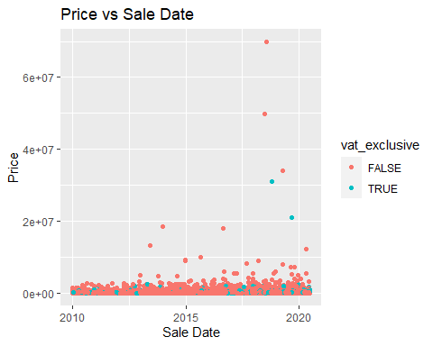
Identifying Outliers in the Dataset
PropertyDataset1a
The data plotted is quite bunched together and not easy to gather a readings from. Outliers are easily identifiable spaced out far from the average price range, whilst the majority of clusters sit in the bottom
ggplot(PropertyDataset1a, aes(sale_date, price)) + geom_point(aes(colour = vat_exclusive)) + labs(x = "Sale Date", y = "Price", title = "Price vs Sale Date")
Notes:
To identify outliers in the dataset I first plotted The data plotted below is quite bunched together and not easy to gather a readings from. Outliers are easily identifiable spaced out far from the average price range, whilst the majority of clusters sit in the bottom
mean(PropertyDataset1a$price)
## [1] 253913

Slide 14
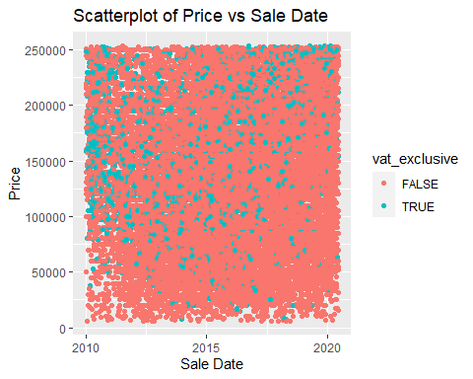
To form a more comprehensible and representative scatterplot, we will remove outliers in the data.
The mean has also reduced to 244532.7 on average paid.
#Filter outliers into new dataframe PropertyData1b <- PropertyDataset1a %>% filter(price <= mean(PropertyDataset1a$price)) # Scatterplot without outliers ggplot(PropertyData1b, aes(x = sale_date, y = price)) + geom_point(aes(colour = vat_exclusive)) + labs(title = "Scatterplot of Price vs Sale Date", x = "Sale Date", y = "Price")
Notes:
# Mean to compare mean(PropertyData1b$price)
## [1] 139291.2
The scatterplot graph is not easy to analyse regardless of filtering outliers. Due to the large amount of data in this dataset, it would need to be filtered further to be easily understandable. Here is an example.

Slide 15
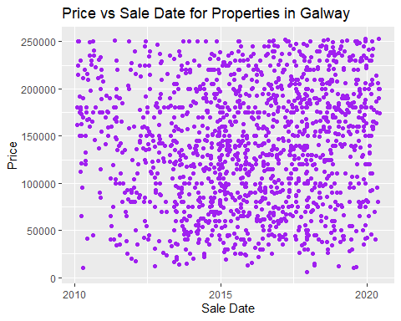
Due to the large amount of data in this dataset, it would need to be filtered further to be easily understandable. Here is an example.
# Example of sales date and price for houses in county Galway gal_prop_data <- PropertyData1b %>% filter(county == "Galway") # Create a scatterplot ggplot(gal_prop_data, aes(x = sale_date, y = price)) + geom_point(colour = "purple") + labs(title = "Price vs Sale Date for Properties in Galway", x = "Sale Date", y = "Price")
Notes:
Clusters can be seen in 2015 at approximately the 100-150,000 price mark

Slide 16
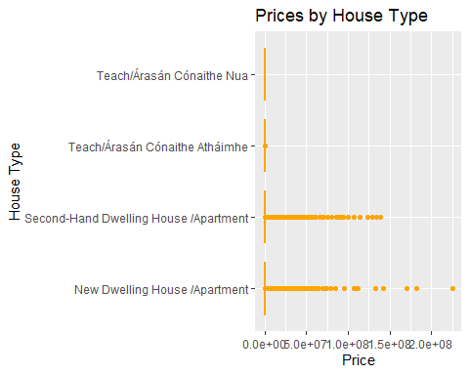
PropertyDataset2a
#Boxplot with all values included ggplot(PropertyDataset2a, aes(x = Description_of_Property, y = Price)) + geom_boxplot(colour = "orange") + labs(title = "Prices by House Type", x = "House Type", y = "Price") + coord_flip()

Slide 17
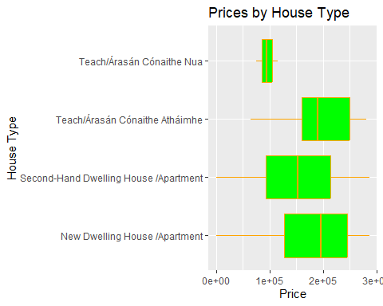
PropertyDataset2b <- PropertyDataset2a %>% filter(Price <= mean(PropertyDataset2a$Price)) ggplot(PropertyDataset2b, aes(x = Description_of_Property, y = Price)) + geom_boxplot(colour = "orange", fill = "green") + labs(title = "Prices by House Type", x = "House Type", y = "Price") + coord_flip()
This boxplot is visually clear and easier to interpret rather than attempting to analyse all the data at once in one graph
Notes:
mean(PropertyDataset2a$Price) #Mean price of a property in Dataset 2
## [1] 286376.5
#Filtering out outliers
# Box plot for filtered PropertyDataset2b

Slide 18




Thank you for listening!
Érin Kennedy
Interpretation of Data
Masters of Science in Data Analytics

Slide 19
References
[@ssayols2017a]
[@zach2020]
[@ieeexpl]
[@!latexe2023]
[@errorwh]
[@inscaven2016]
file:///C:/Users/erink/Downloads/rmarkdown%20(2).pdf - RMarkdown Cheatsheet, Rstudio
(Tableau, 2023, Data Cleaning: Definition, Benefits, And How-To | Tableau)

